Slide 1
Unit 9 Electromagnetism
Part D: Electromagnetic Induction
Notes:
Hi! Welcome to Unit 9: Electromagnetism, Part D on Electromagnetic Induction

Slide 2
What will you learn?
Electromagnetic Induction
Faraday’s Law
Lenz’s Law

Slide 3
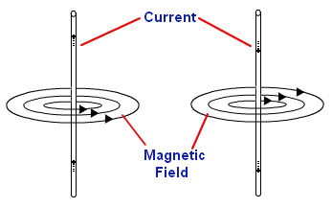
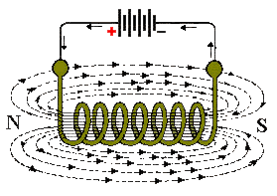
Introduction to Magnetic Induction
In preceding parts of this unit, we learned that a current-carrying conductor produces a magnetic field around it, perpendicularly to the current flow direction.
Electromagnet is a result of electromagnetism.

Slide 4
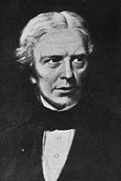
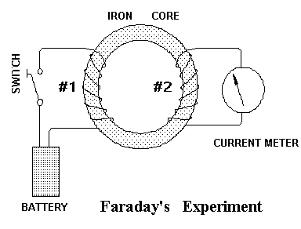
Introduction to Magnetic Induction
Michael Faraday believed that electromagnetism works both ways.
He set up an experiment and found that by magnetizing the iron ring core via coil #1,
the flux linking to coil #2 caused a deflection in the meter.
?
+
-

Slide 5
Introduction to Magnetic Induction
Michael Faraday noticed the deflection in the meter occurred every time he closed the switched, and every time he opened it.
It is the change in flux Δ𝛷 that produces electricity.
This phenomenon is called electromagnetic induction.
+
-

Slide 6
Introduction to Magnetic Induction
There are other setups to demonstrate electromagnetic induction:
moving a magnet towards or away from a conductor or solenoid,
moving the conductor & cutting flux lines in a magnetic field, or
placing a conductor in a changing magnetic field.
All demonstrations have the flux lines cut by the conductor or coil.

Slide 7
Introduction to Magnetic Induction
Note the current direction when magnet is approaching.
Note the change in current direction when magnet is leaving.
The induced current in the coil produces its own magnetic field B_{induced}.
Note how B_{induced} interacts with the magnet.

Slide 8
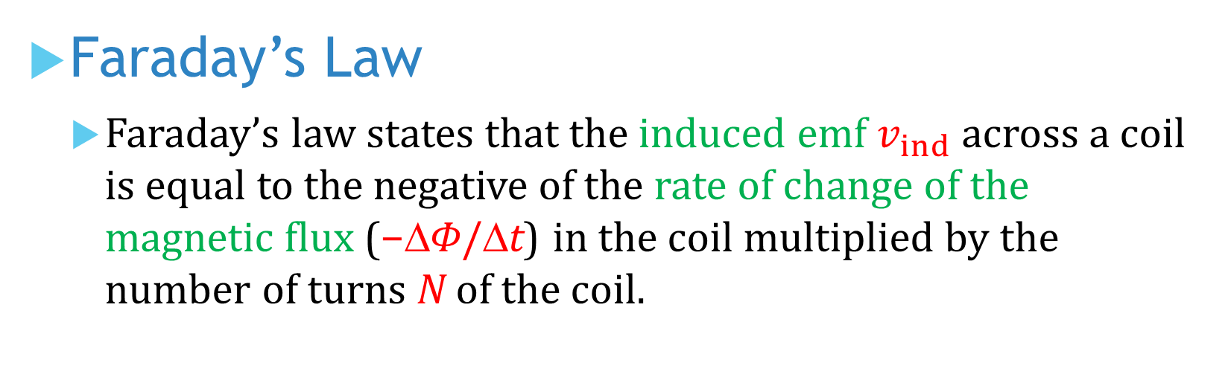
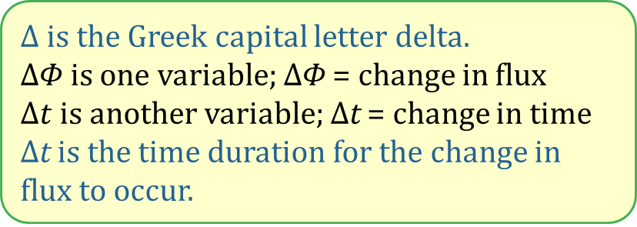
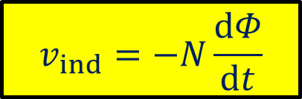
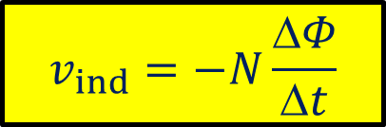
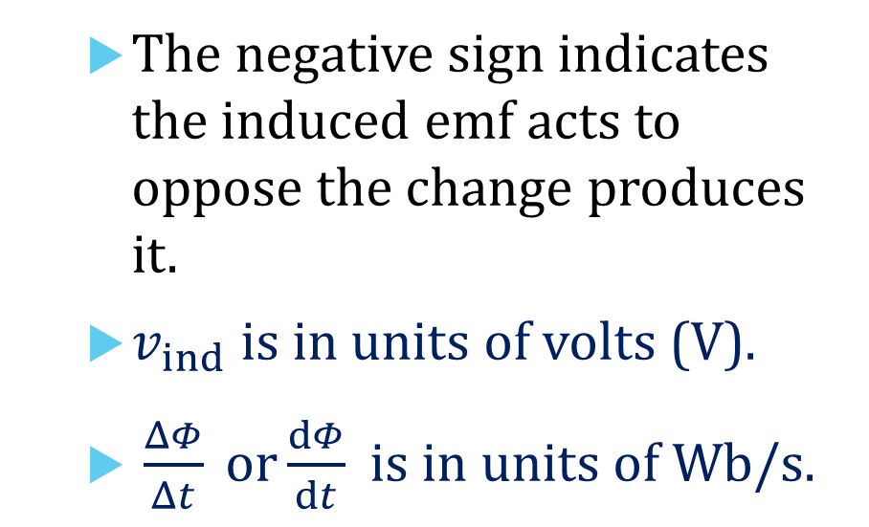
Faraday’s Law
Faraday’s law states that the induced emf $v_{ind}$ across a coil is equal to the negative of the rate of change of the magnetic flux (−Δ𝛷/Δt) in the coil multiplied by the number of turns N of the coil.
$$v_{ind}=−N\frac{ΔΦ}{Δt}$$
The negative sign indicates the induced emf acts to oppose the change produces it.
$v_{ind}$ is in units of volts (V).
$\frac{ΔΦ}{Δt} or\frac{dΦ}{dt}$ is in units of Wb/s.
or
$$v_{ind}=−N\frac{dΦ}{dt}$$
$Δ$ is the Greek capital letter delta.
$Δ$𝛷 is one variable; $Δ$𝛷 = change in flux
$Δt$ is another variable; $Δ$t = change in time
$Δ$t is the time duration for the change in flux to occur.

Slide 9
Lenz’s Law
Lens’s law states that the induced current flows in a direction such that the current acts to oppose the change inducing it.
Both Faraday’s law and Lenz’s law work together in explaining the magnitude and polarity of the induced voltage and direction of the induced current.

Slide 10

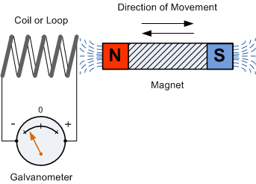

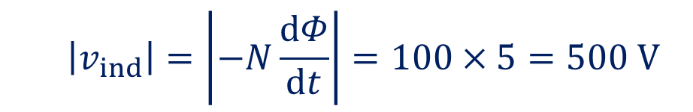
Example 1: Apply Faraday's law to find the magnitude of the induced voltage across a coil with 100 turns. The coil is placed in a magnetic flux which is changing at a rate of 5 Wb/s.
$$\left|v_{ind}\right|=\left|−N\frac{dΦ}{dt}\right|=100×5=500 V$$

Slide 11
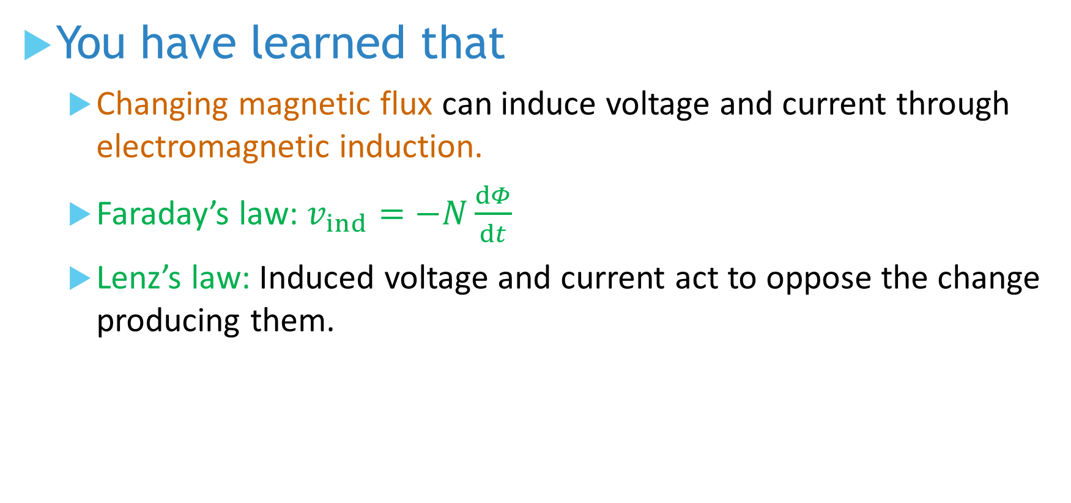
You have learned that
Changing magnetic flux can induce voltage and current through electromagnetic induction.
Faraday’s law: $v_{ind}=−N\frac{dΦ}{dt}$
Lenz’s law: Induced voltage and current act to oppose the change producing them.

Slide 12
Coming Up Next
AC Voltage and Current

